Slide 1
Array
Dr. Eman Mounir
Eng. Gehad Mustafa
Eng. Eman Samy

Slide 2
What is Data Structure?
A data structure is a storage that is used to store and organize data.
It is a way of arranging data on a computer so that it can be accessed and updated efficiently.

Slide 3
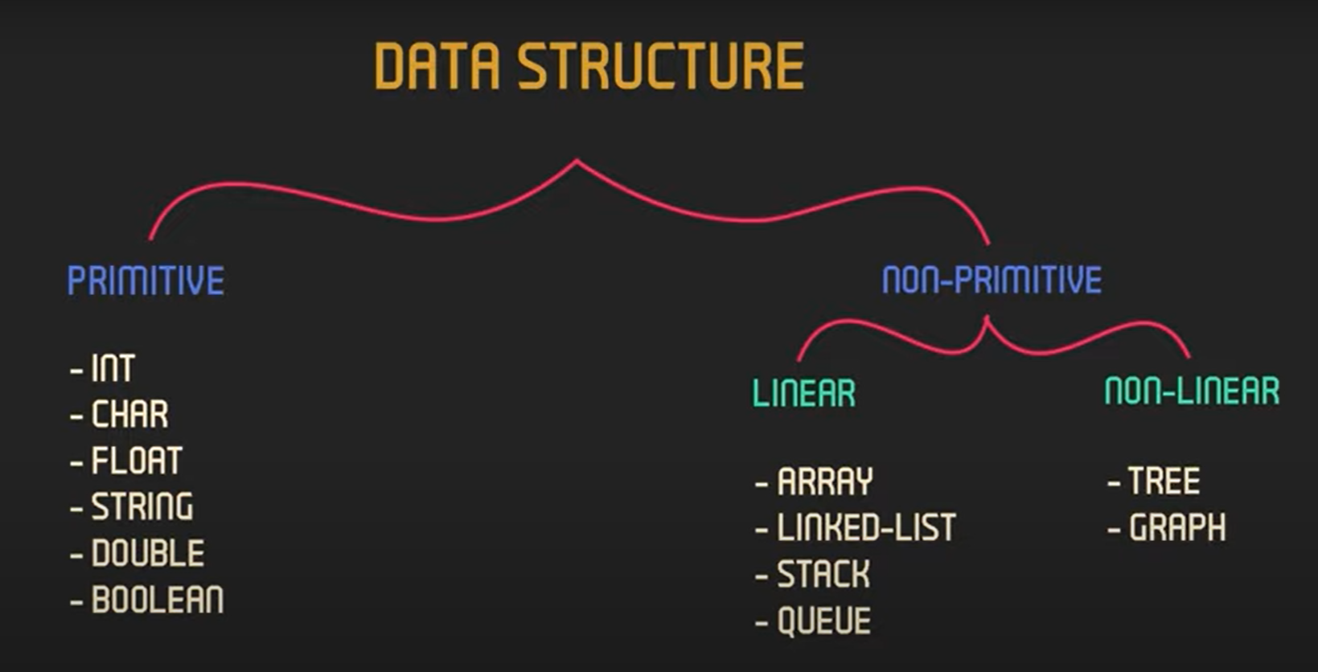
Data Structure
(BUILT IN)

Slide 4
Array
Consecutive group of memory locations that all have the same type.
The collection of data is indexed, or numbered
at starts at 0
the highest element index is one less than the total number of elements in the array

Slide 5
Types of array
Single-dimensional array :
elements are arranged in list form.
Multi-dimensional array:
elements are arranged in tabular form.

Slide 6
Declaring Arrays
array_type array_name [ no. of element ] ;
array_type array_name [ no. of element ] ={data,data,…..};
array_type array_name [ ] ={data,data,…..};
array_type array_name [ no. of element ] ;
array_name [ 0]=data;
.
.
array_name [ no. of element -1 ]=data;

Slide 7
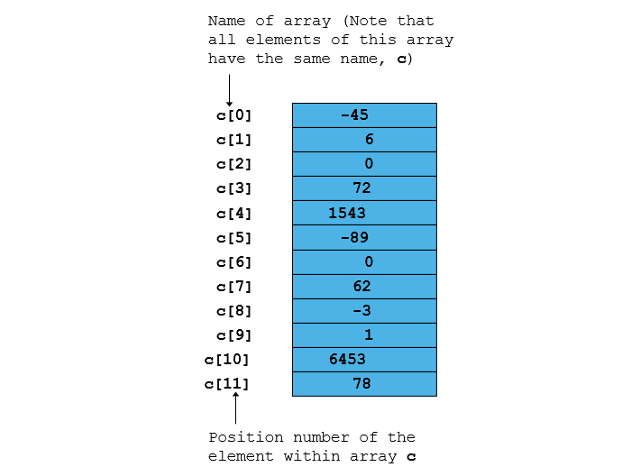

Slide 8
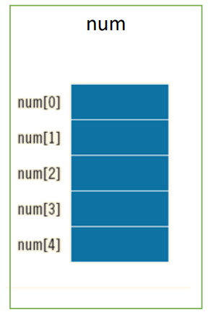
single-dimensional
Example:
Int num [ 5];
Same
const int size = 5;
Int num[ size];

Slide 9
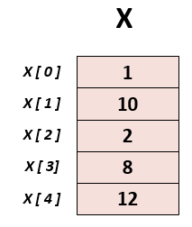
Example
int X [ 5 ] ;
X [ 0 ] = 1 ; X [ 1 ] = 10 ; X [ 2 ] = 2 ;
X [ 3 ] = 8 ; X [ 4 ] = 12 ;
Or
int X [ 5 ] = { 1, 10, 2, 8, 12} ;

Slide 10
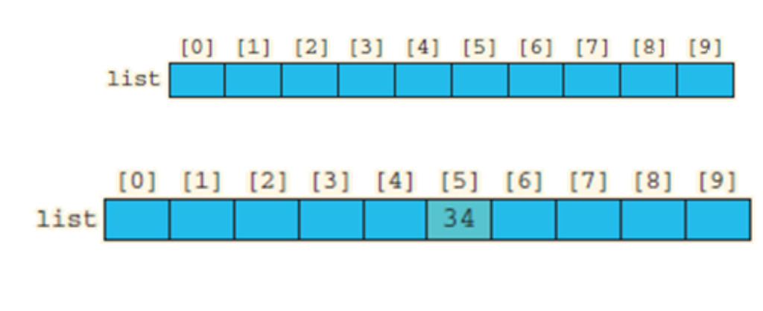
Example
int list [10]=;
list[5 ] = 34;
cout<< list [5];

Slide 11
Try
Try to create an array from scratch and then multiply it by 5

Slide 12
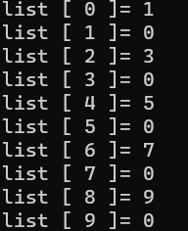
Try
Try to print this output

Slide 13
Try
What is the O/P?
int list [ 10 ] = { 2, 1, 2, 1, 1, 2, 3, 2, 1, 2 } ;
cout << list [ 2 ] ;
cout << list [ list [ 2 ] ] ;
cout << list [ list [ 2 ] + list [ 3 ] ] ;
cout << list [ list [ list [ 2 ] ] ] ;

Slide 14
Try
Try to print the sum of even and sum of odd numbers in the 1-d entered array.

Slide 15
Try
Write a program to reverse the array out of place

Slide 16
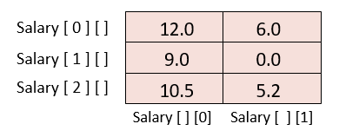
Multidimensional Arrays
array_type array_name [no. of rows] [no. of columns];
Example:
float Salary [ 3 ] [ 2 ] = { 12.0, 6.0, 9.0, 0.0, 10.5, 5.2} ;
OR
float Salary [ 3 ] [ 2 ] = { {12.0, 6.0} , {9.0, 0.0} , {10.5, 5.2}} ;

Slide 17
Try
Try to print the row sum and column sum of a matrix.

Slide 18
Try
Adding the diagonal Elements of an Array

Slide 19
Try
Adding two matrices

